Slide 1
Routine correspondence

Slide 2
Confirmation
On information pertaining to purchase of services and products
Verifies the details of the agreement
Summarizes the results of discussion, confirming payments, dates, and training content

Slide 3
Confirmation
Introduction includes context of last correspondence for relatability. Informs the reader of when, where and what of the topic/correspondence
Discussion specifies terms agreed upon
Summarizes the results of discussion, confirming payments, dates, and training content
Specific action such as a request for signature, payment due dates or method of payment
Use highlighting techniques for adding specifics like date, time, location, length of agreement etc.

Slide 4
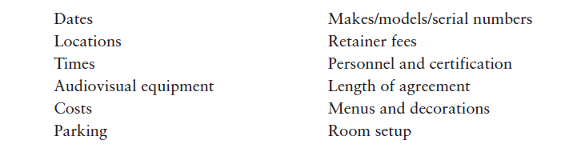

Slide 5
Recommendation
Employee promotion cases
An ex-employee’s reference for a new job opportunity
Acquaintance applying for education scholarship/fellowship
Consultant requests reference for a new client

Slide 6
Recommendation
Includes position/title, relationship with referee, length of relationship, their name, position/scholarship/award
Introduction
Discussion includes examples of performance, illustrations of potential benefits to company, chances of success, unique attributes.
Conclusion includes why they deserve consideration for job/award/scholarship and contact information for follow-up.
Also includes example projects, projects supervised if any, team skills, communication abilities, certifications, and honors.

Slide 7
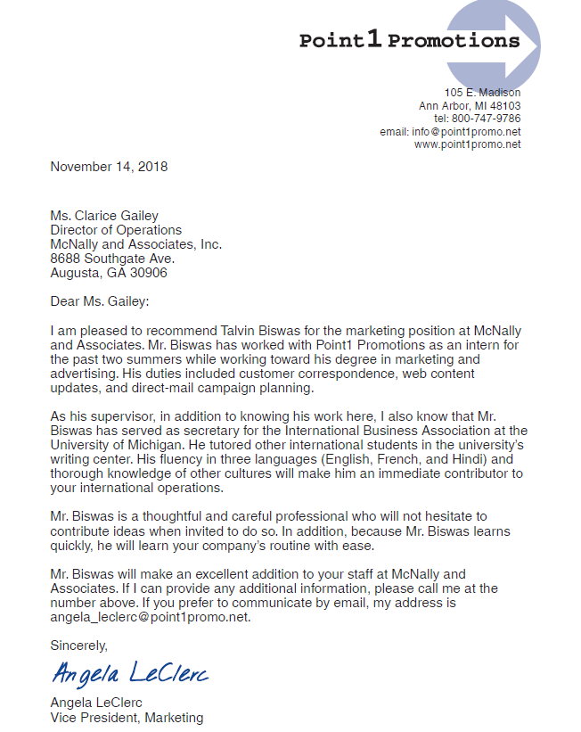
Opening clearly states candidate’s full name and specific purpose of letter
Specific examples to support the candidate’s positive evaluation
Summarizes candidate’s recommendation and invites further communication

Slide 8
Strategy for Positive Messages
Starting with the main idea first
Providing necessary details and explanation
Ending with a courteous close

Slide 9
Put the main idea first
Prepare your audience for details that follow
Clear and concise opening
Main idea could be a positive reply or a good news for reader

Slide 10
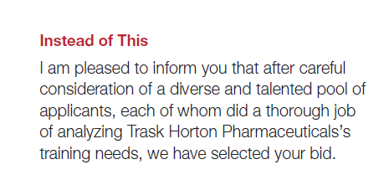
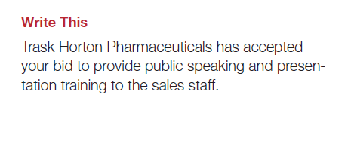

Slide 11
Providing necessary details and expression
Maintain supportive tone
Use body to explain detail of your point and justify it
Put the negative portion (if any) of your message into as favorable a context as possible
If you are communicating with a customer, resale message can be added to build customer relationships
Short and specific

Slide 12
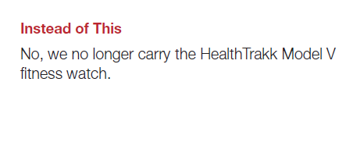
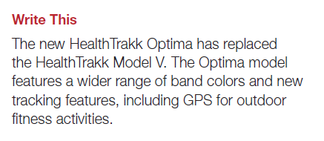

Slide 13
Courteous close
Identify who will do what and what action will take place
Reader benefit: Personal well-being of reader
How to proceed and encourage them to act promptly

Slide 14
For Adjustment messages
Specific response to complaint depends upon your company’s policies for resolving such issues and which party(or parties) lie at fault.
Steps to be taken
If you choose to grant the claim, open with good news
Acknowledge, sympathize with customer, take (or assign) personal responsibility, explain precisely, take steps to repair relationship and follow up to verify your response effectiveness

Slide 15
Announcing good news
Examples include press release or news release (now also social media release)
Good news is welcome so use the direct approach
Good news followed by details and a positive close
Social media releases: include ready-to-share content

Slide 16
Offering condolences
Brief personal messages written to comfort someone after the death of a loved one
Timing
Media choice
Short, simple and sincere
Sharing brief and positive memories adds meaning and depth
Avoid trite remarks or advice
Avoid religion in your discussion to avoid offense
Inappropriate sentiments

Slide 17
Offering condolences
Brief personal messages written to comfort someone after the death of a loved one
Timing
Media choice
Short, simple and sincere
Sharing brief and positive memories adds meaning and depth
Avoid trite remarks or advice
Avoid religion in your discussion to avoid offense
Inappropriate sentiments

Slide 18
Writing negative Messages

Slide 19
Bad messages
To handle bad news carefully
Deemphasize the bad news visually and grammatically
Use a conditional statement, if appropriate
Tell what you did do, not what you didn’t do
Don’t disguise bad news when you emphasize the positive.

Slide 20
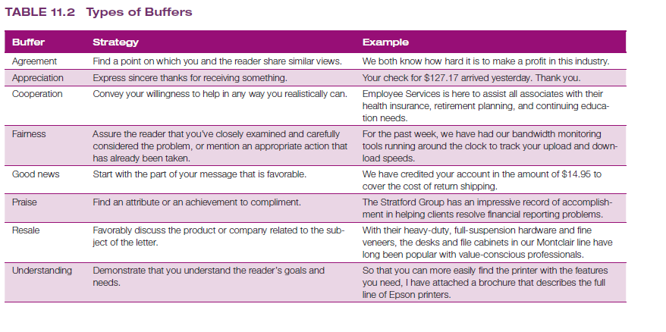
Use logic rather than “company policy” as a ruse while delivering bad news

Slide 21
Writing Persuasive Messages
Analyzing the Situation
Gathering information
Organizing information
Framing your Argument

Slide 22
Persuasive messages
More challenging to write
Ask audiences to give something of value
Take substantial action

Slide 23
Analyzing the situation
Considering the audience
Demographics
(occupation, age, income/education)
Motivation
(physiological, safety/security, affiliation and belonging, power and control, achievement, adventure and distraction, knowledge and exploration, aesthetics, self-actualization, helping others)
Psychographics
(attitudes, personality, lifestyles,
psychological characteristics)

Slide 24
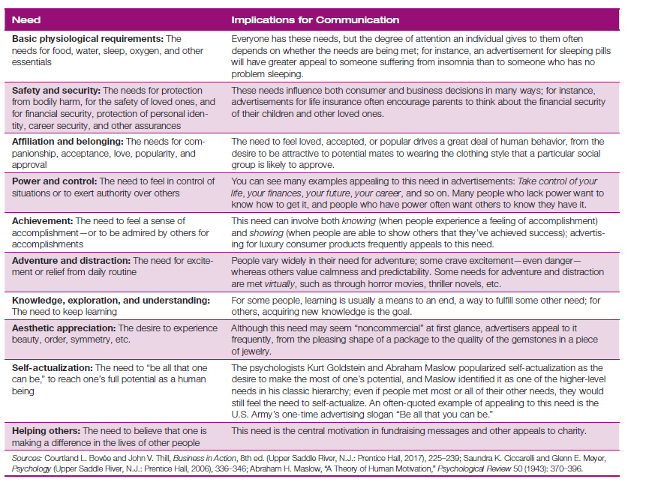

Slide 25
Selecting the right media channel
Maximize the chance of getting through to your audience
Varied according to the message

Slide 26
Organizing your information
The “you” attitude
Reader involvement
Make it about receiver and not sender
Limiting your scope is vital
Use of indirect approach usually
Focus on benefits to readers and not how it will help you
It all depends on power dynamics and your authority over the reader(s) involved.

Slide 27
Writing Persuasive messages: Considerations
Use polite and positive language
Understanding and respecting cultural differences
Being sensitive to organizational cultures
Establish credibility
Do not insult readers
You know what you are talking about and are not misleading audience

Slide 28
Framing your arguments
Usually use indirect approach
AIDA model
AIDA model
Attention
Interest
Desire
Action

Slide 29
AIDA Model
Attention: Encourage your audience to hear about your problem/issue
Interest: Additional details that prompt readers towards benefits
Desire: Explaining how the idea will benefit them
Action: Specific action required
Main idea

Slide 30
Uses
Tailor made for indirect approach
Also used in direct approach
Desire: Explaining how the idea will benefit them
Action: Specific action required
Save your main idea for the action phase
in which you glimpse main idea as attention getter, create desire with evidence and reemphasize main idea in action phase

Slide 31
Limitations
Built around a single event
A conversational approach is more compatible in today’s ethos
Unidirectional method
Talks at audience not with them
Your goal is to help them arrive at a decision and not build mutual, long-term relationships

Slide 32

Tone for persuasive messages
Logos
Pathos

Slide 33
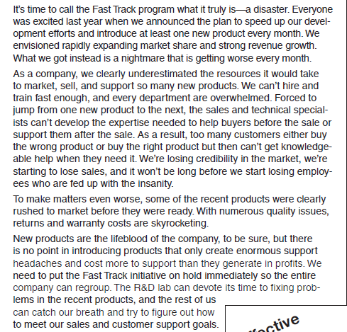
Activity
Imagine you’re the marketing manager in a company that decided to speed up its new product launches but did too much too fast and wound up creating chaos. You decide enough is enough and write a memo to the company president advocating that the new program be shut down until the company can regroup—a suggestion you know will meet with resistance.
Spot the issues in the approach followed to design this correspondence and redraft it to correct them.

